Slide 1
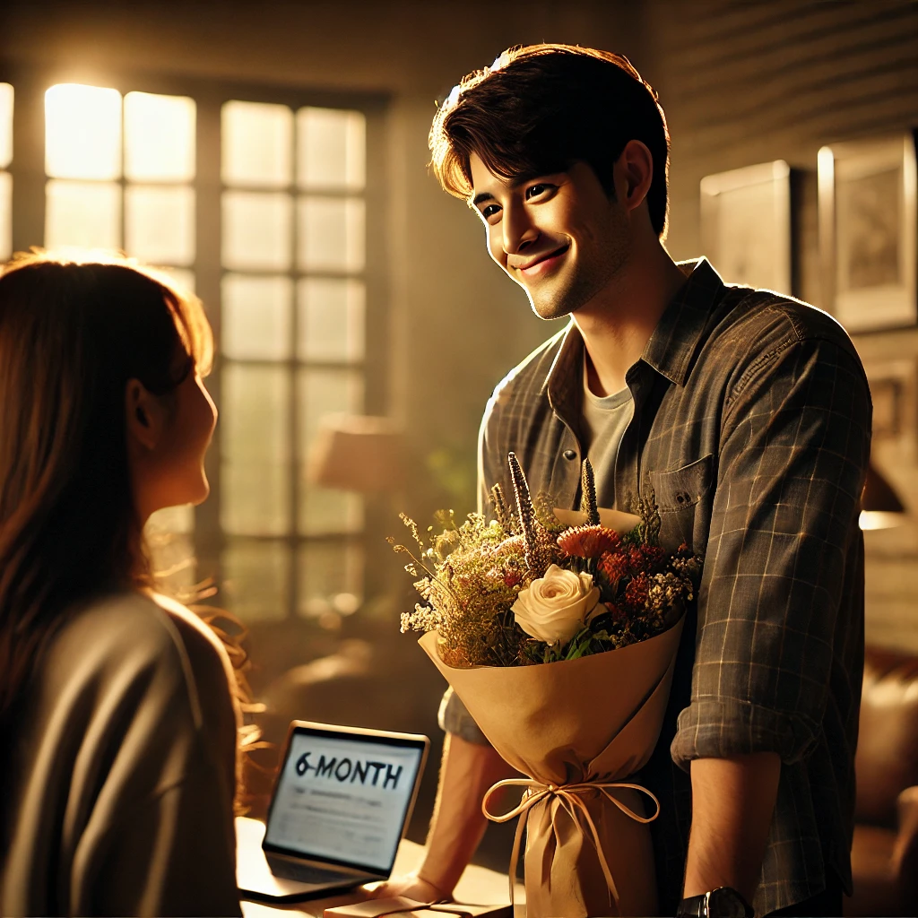

Slide 2

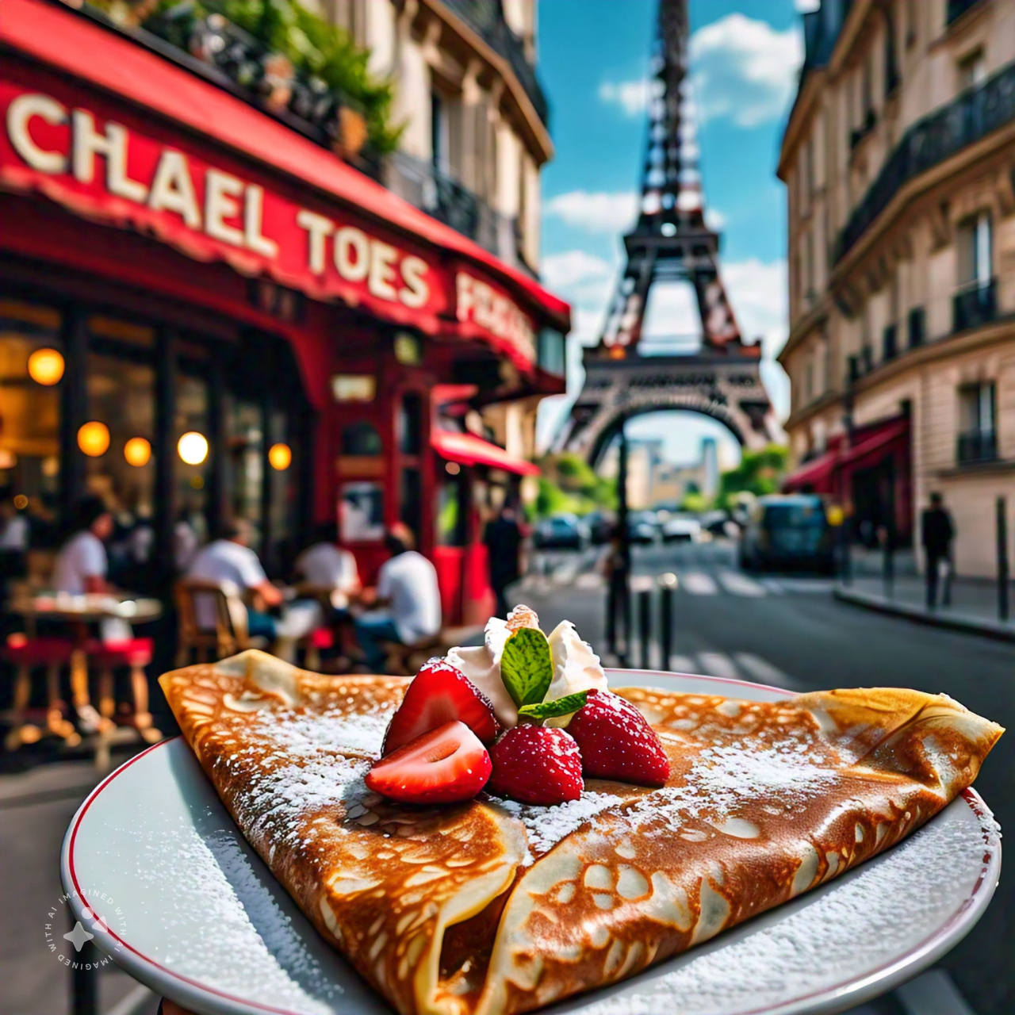

Slide 3


Slide 4


Slide 5
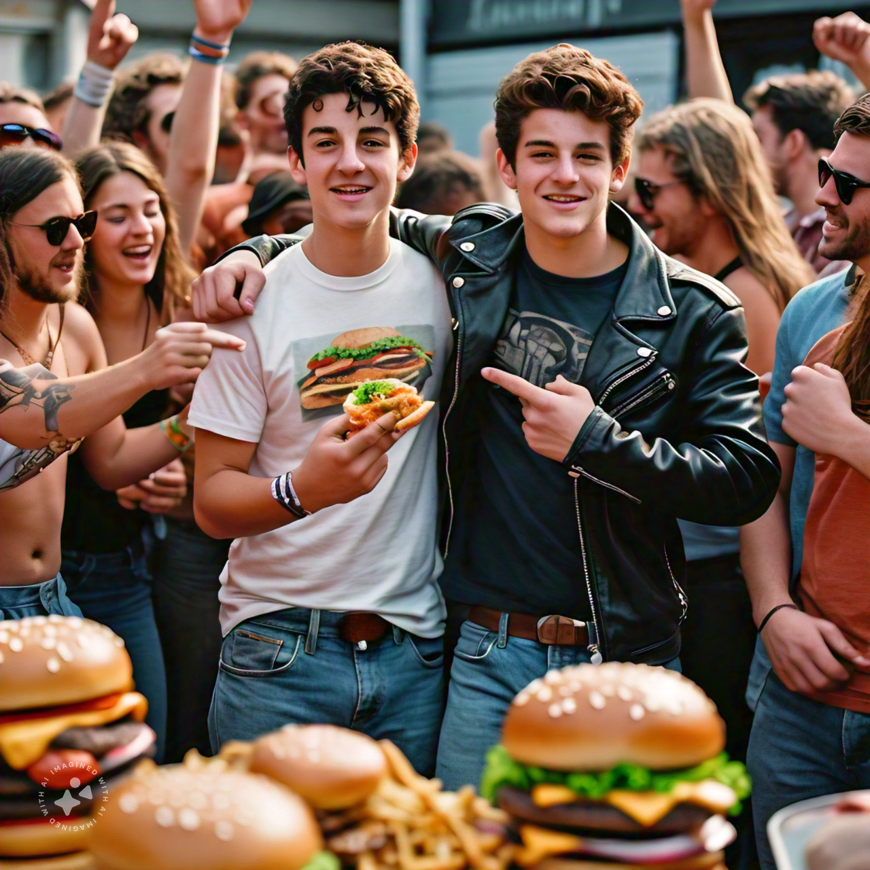

Slide 6
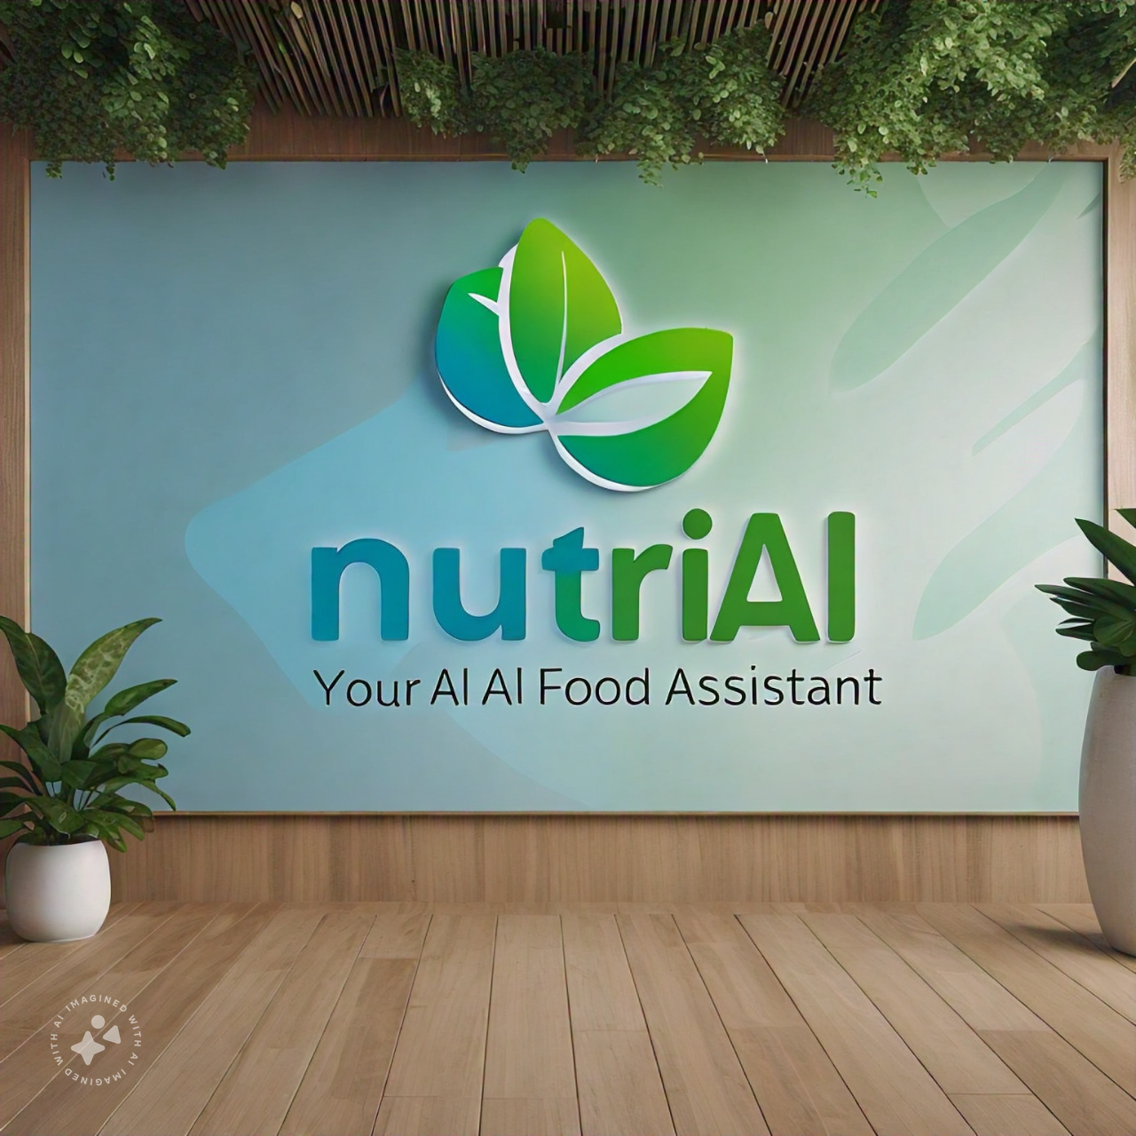


Presenter: Rajesh Velamala
Sravya Kottisa

Slide 7
Our Mission
Empower individuals to make informed food choices and develop healthier habits through AI-driven nutrition guidance, becoming the go-to platform for personalized nutrition and wellness.

Slide 8
Value Proposition
Convenience
Instantly identify food items and access nutritional information with just a photo upload.
Personalization
Receive tailored dietary advice based on individual needs and preferences.
Accuracy
AI-driven food recognition ensures precise nutrition facts and recommendations.
Community
Join a supportive network of health-conscious individuals for motivation and guidance
Partnership Opportunities
Collaborate with food brands, health organizations, and wellness experts for integrated solutions
Continuous Improvement
Machine learning algorithms ensure ongoing enhancement, refinement and expansion to other cuisines.

Slide 9
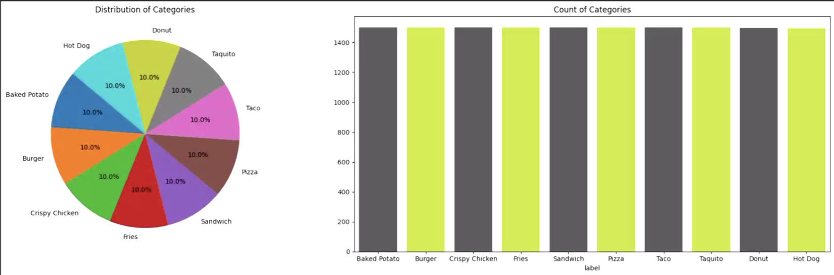
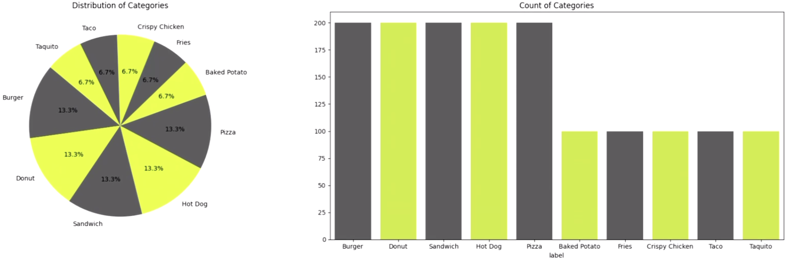
Our Approach
Data Collection: Kaggle, Hugging Face,
Google images
Data Pre-processing:
Clean, transform, and prepare data for modeling
Handle outliers, and data normalization & augmentation
Exploratory Data Analysis (EDA):
Collected 15K images in various formats (jpg, png, gif etc.)
10 food categories
Training set (11,993)
Validation Set( 2,998)
Test Set (1,500)

Slide 10
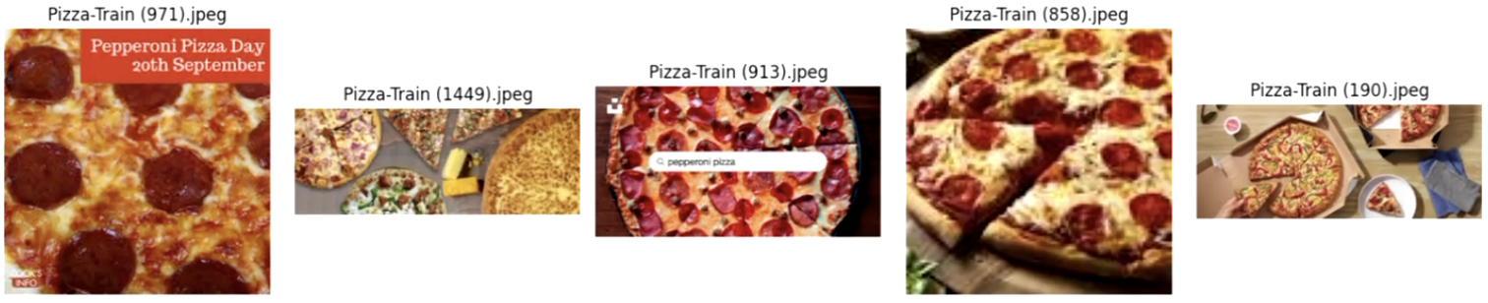
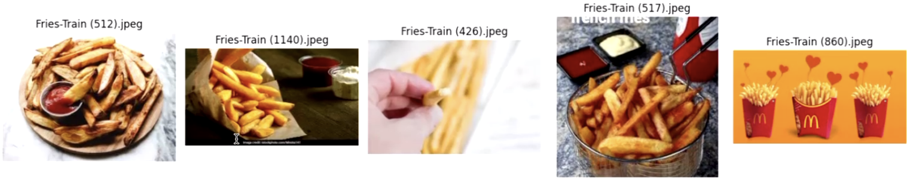
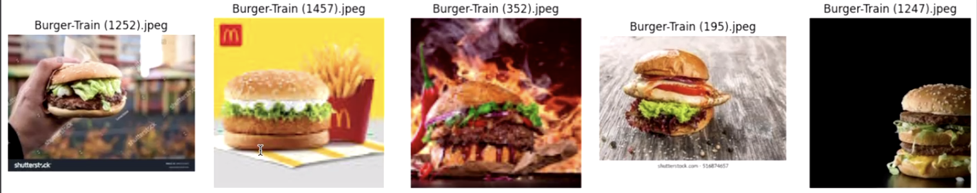
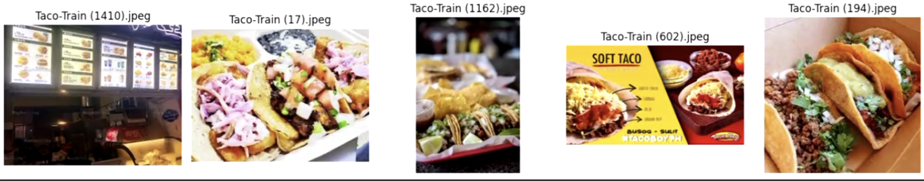
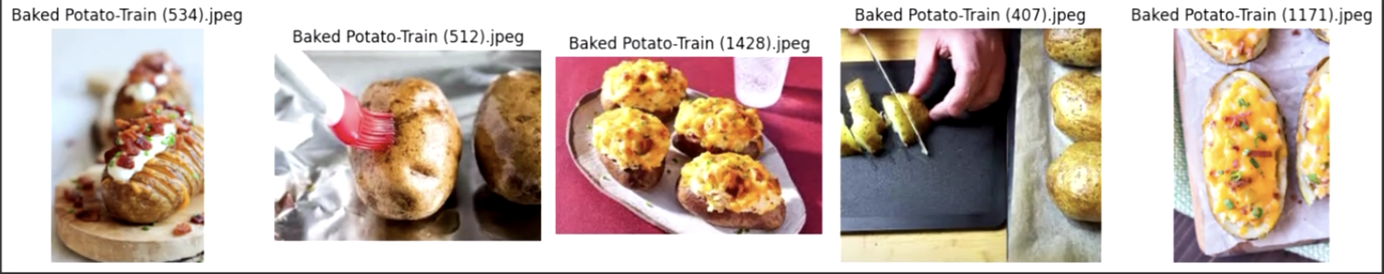
Sample Data

Slide 11
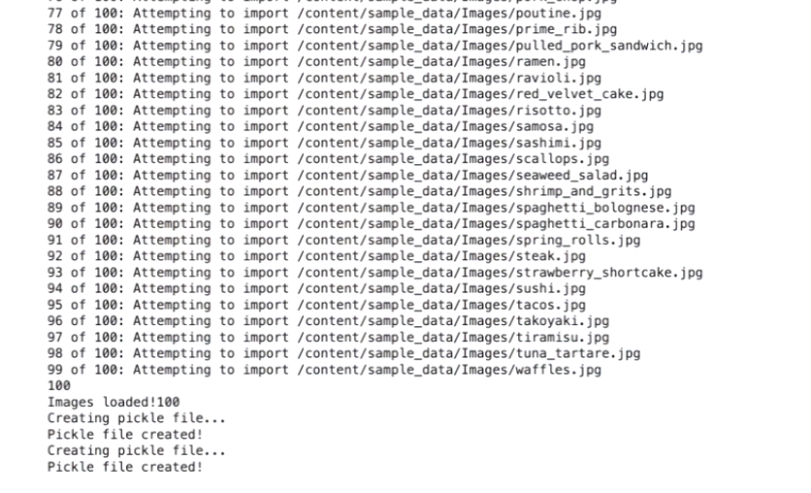
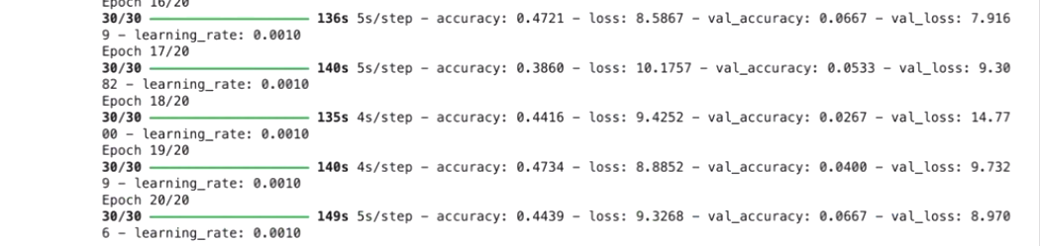
Model Performance & Challenges
Model: Sequential
Environment: Google Collab CPU/GPU/TPU
Input Data Set: 15K Images
Outcome: System Crashed
Next Step: Changed the data set to only 100 images
Model Performance: 44.39%

Slide 12
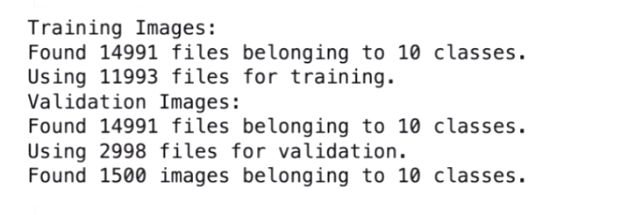
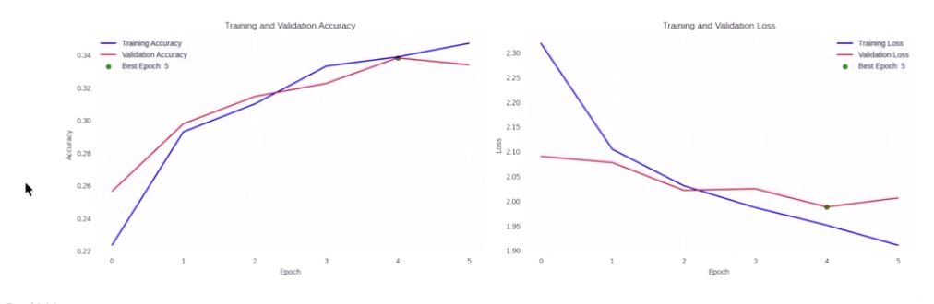
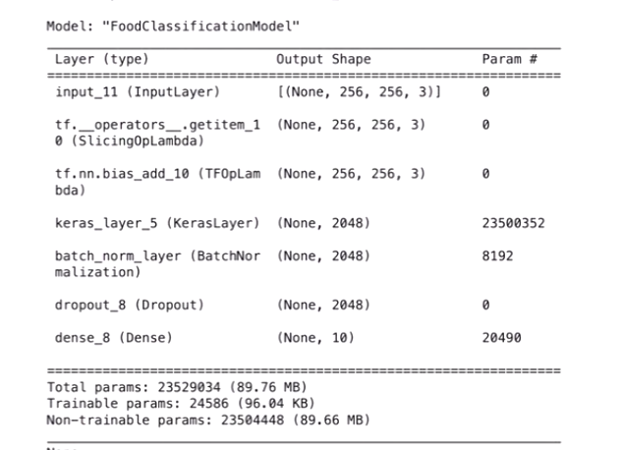
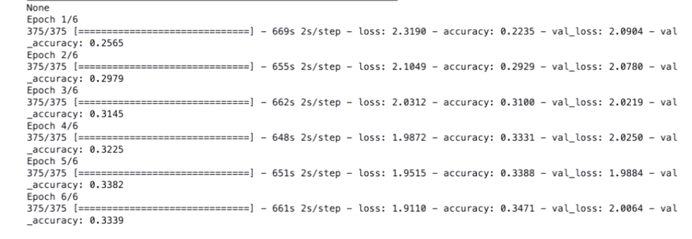
Model Performance & Challenges
Model: Resnet
Environment: Google Collab CPU/GPU
Input Data Set: 15K Images
Outcome: Took more than 5hrs
Next Step: Migrated to Google Collab TPU(Collab Pro)
Model Performance: 34.71%

Slide 13
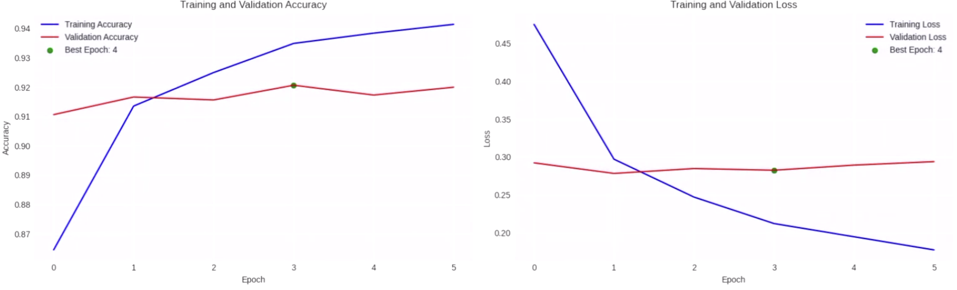
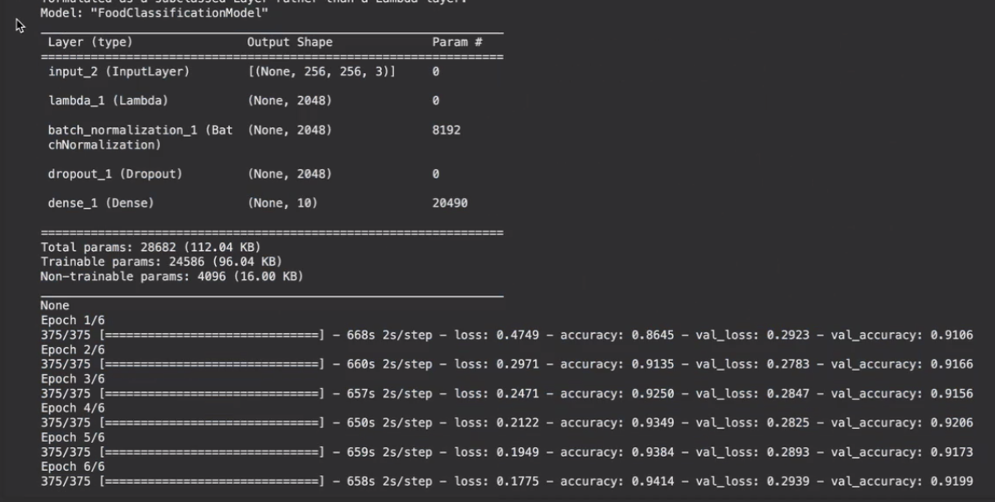
Model Performance & Challenges
Model: Resnet with finetuning (Batch Normalization & Dropout)
Environment: Google Collab TPU(Collab Pro+)
Input Data Set: 15K Images
Outcome: Took about 1 hour to train
Model Performance: 94.14%
Libraries Used:
Tensorflow
Gradio
Tensorflow Hub
Keras
Matplotlib
Sklearn
OpenAI
Resnet
LangChain
LangChain Community
Accuracy: 0.9414
Loss:0.1775
Val_Loss:0.2939
Val_accuracy:0.9199

Slide 14
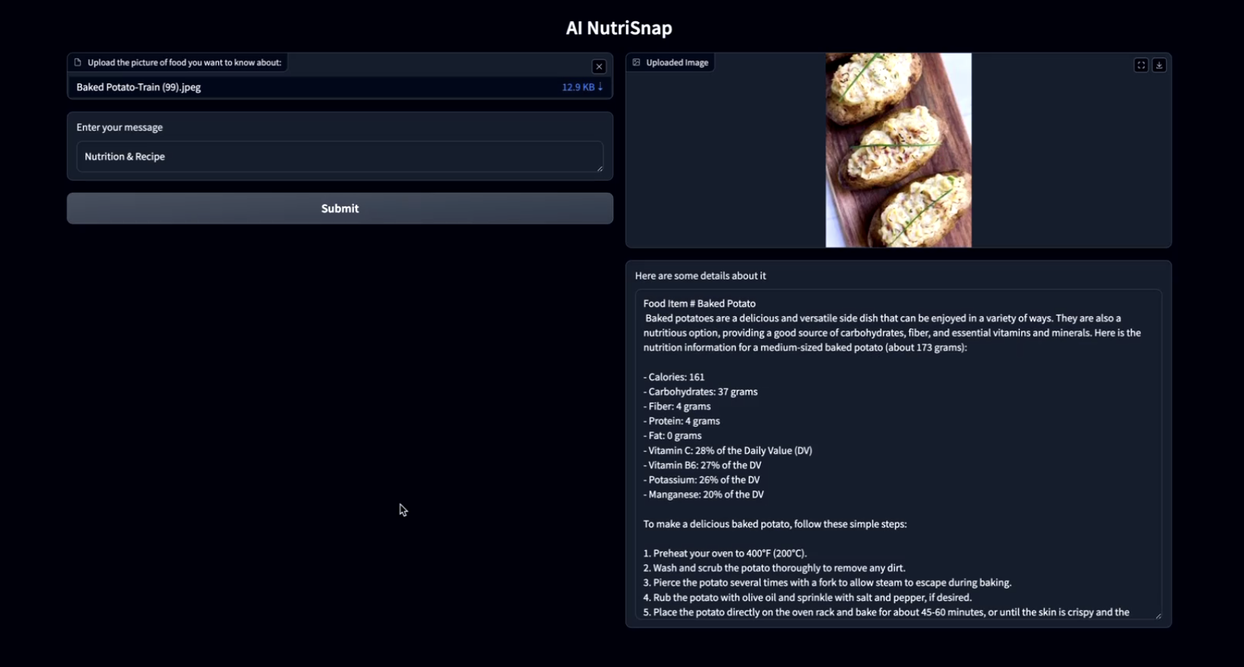
Demo

Slide 15
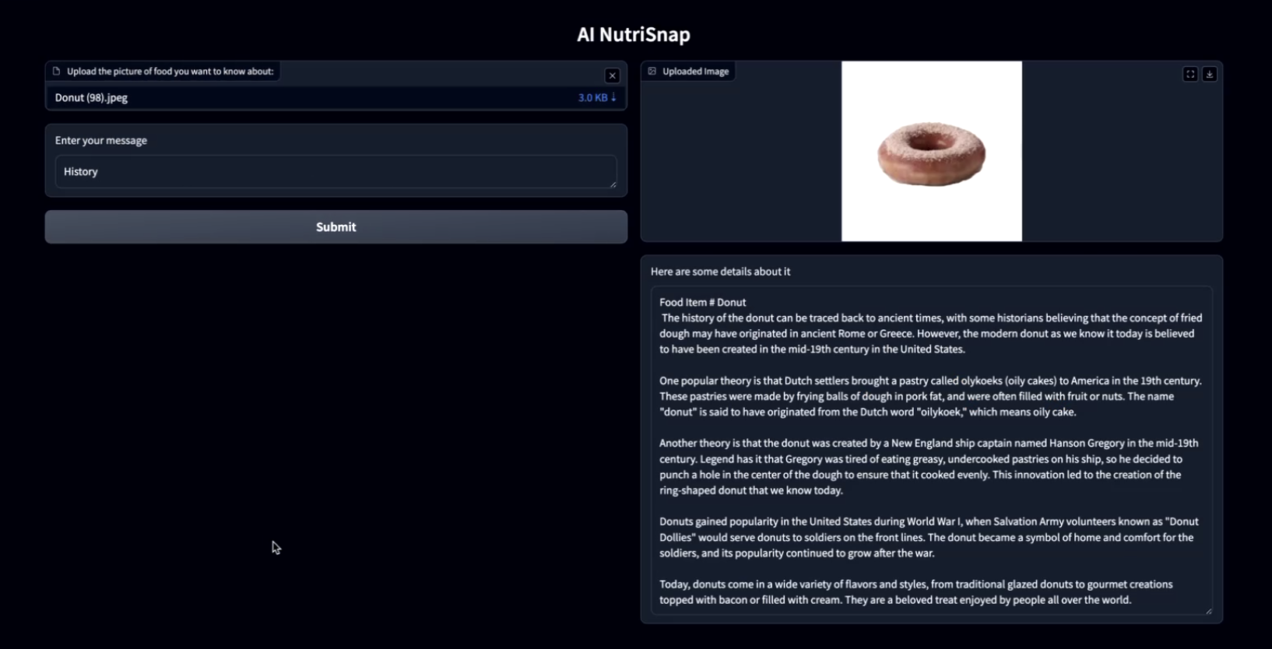
Model Performance & Challenges

Slide 16
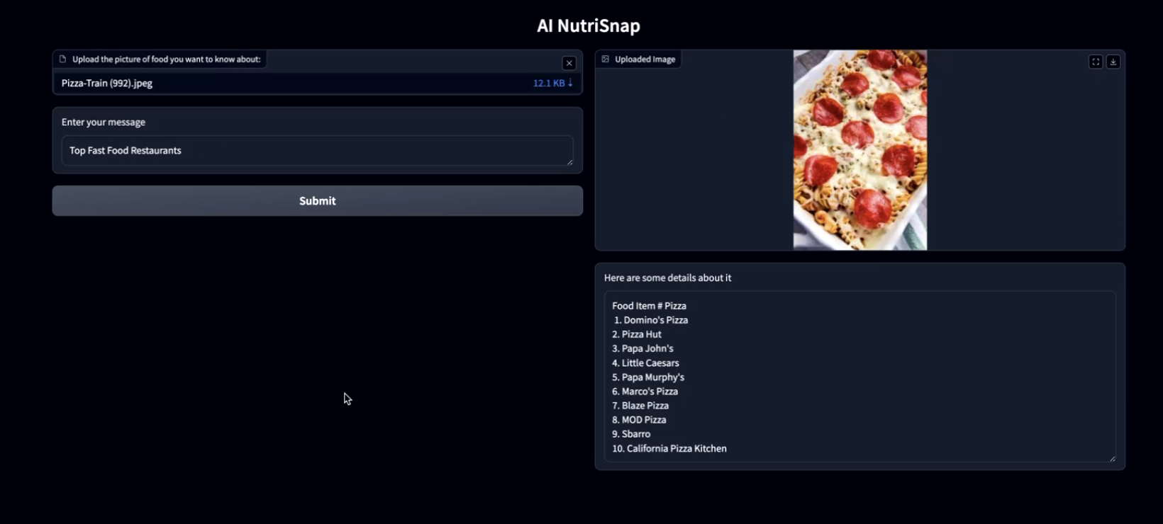
Model Performance & Challenges

Slide 17
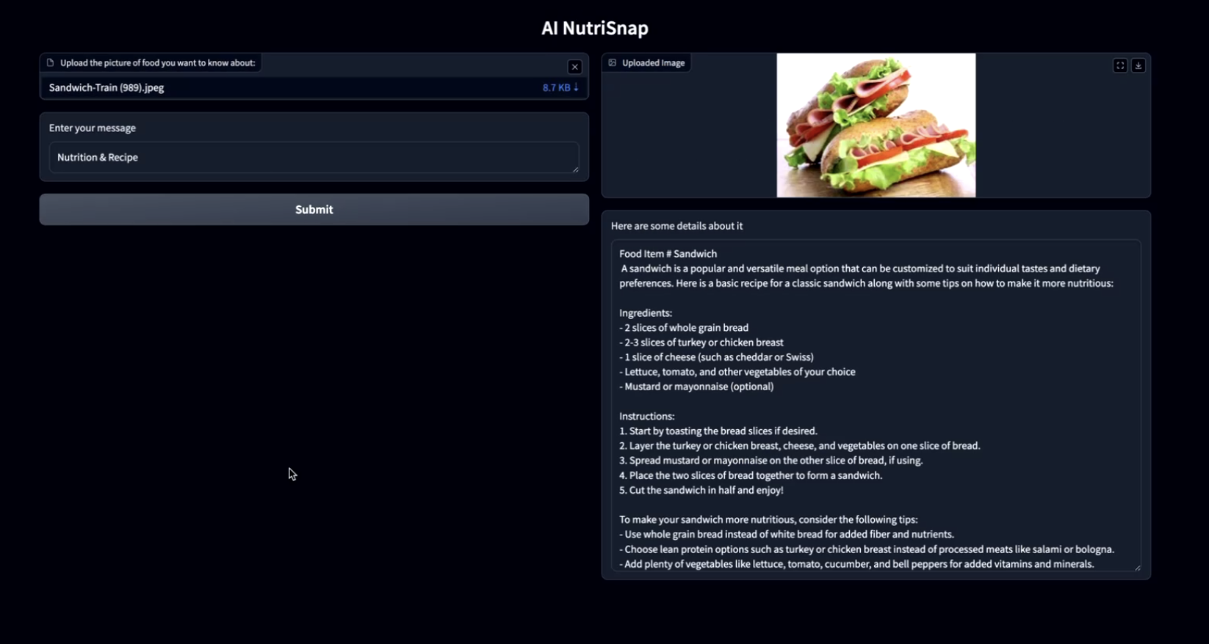
Model Performance & Challenges

Slide 18
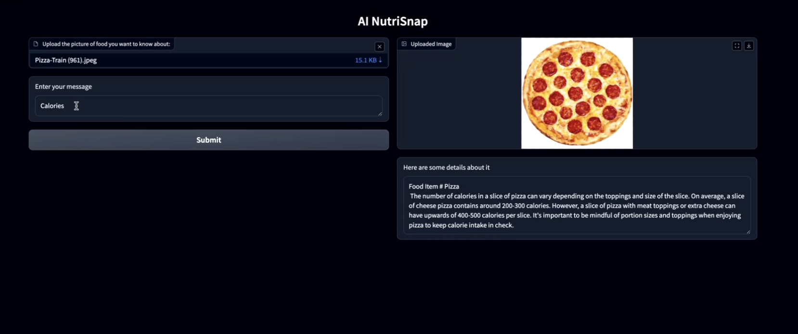
Model Performance & Challenges

Slide 19
Demo

Slide 20
Future Development
Develop and Launch: Launch a functional and user-friendly app with AI-powered food recognition and personalized nutrition guidance and extend to more than 1000 food categories
User Acquisition: Market to reach 100,000 registered users & subscribers
Partnerships: Establish partnerships with 5 food industry stakeholders and 2 healthcare providers.
Database Expansion: Expand the database to include 50,000 food categories and international cuisines
Scale Solution:
Expand to other Markets & industries

Slide 21
Q & A

